Slide 1
thesis plots
2019-2021
Jie Hu

Slide 2
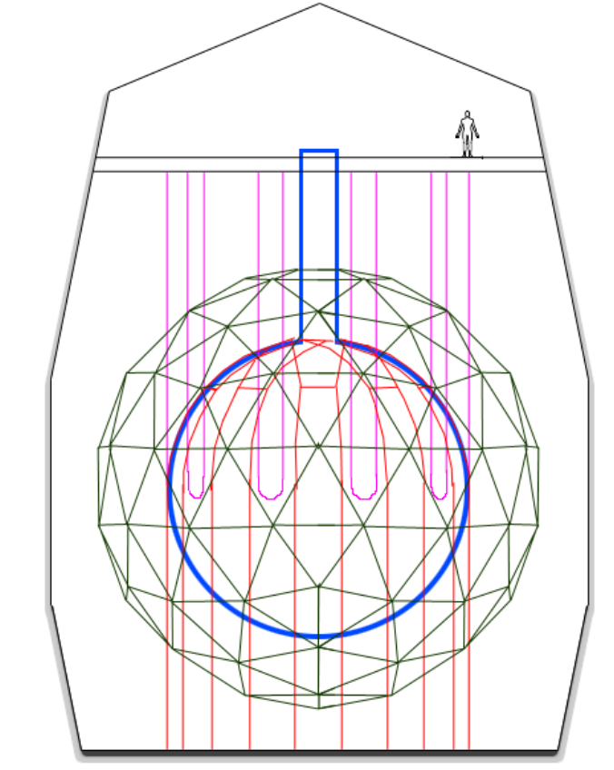
Deck
Neck
Hold-up ropes
PMT support structure
Rock cavity
Acrylic vessel
Hold-down ropes

Slide 3
pp
pep
p + p → ²H + e⁺ + ν_{e}
p + e⁻ + p → ²H + ν_{e}
99.76%
0.24%
²H + p → ³He + γ
84.6%
15.4%
2.5x10⁻⁵%
hep
³He + ³He → ⁴He + 2p
³He + ⁴He → ⁷Be + γ
³He + p → ⁴He + e⁺ + ν_{e}
pp-I
99.89%
⁷Be
0.11%
⁷Be + e⁻ → ⁷Li + ν_{e}
⁷Be + p → ⁸B + γ
⁸B
⁷Li + p → 2 ⁴He
⁸B → ⁸Be* + e⁺ + ν_{e}
pp-II
pp-III

Slide 4
¹³C
¹³C + p → ¹⁴N + γ
¹⁴N
¹⁷O + p → ¹⁴N + ⁴He
¹⁷O
¹³N → ¹³C + e⁺ + ν_{e}
¹⁴N + p → ¹⁵O + γ
¹⁷F → ¹⁷O + e⁺ + ν_{e}
CN
NO
¹²C + p → ¹³N + γ
¹⁵O→ ¹⁵N + e⁺ + ν_{e}
¹⁶O + p → ¹⁷F + γ
¹²C
¹⁵N + p → ¹²C + ⁴He
¹⁵N
¹⁵N + p → ¹⁶O + γ
¹⁶O
cycle

Slide 5
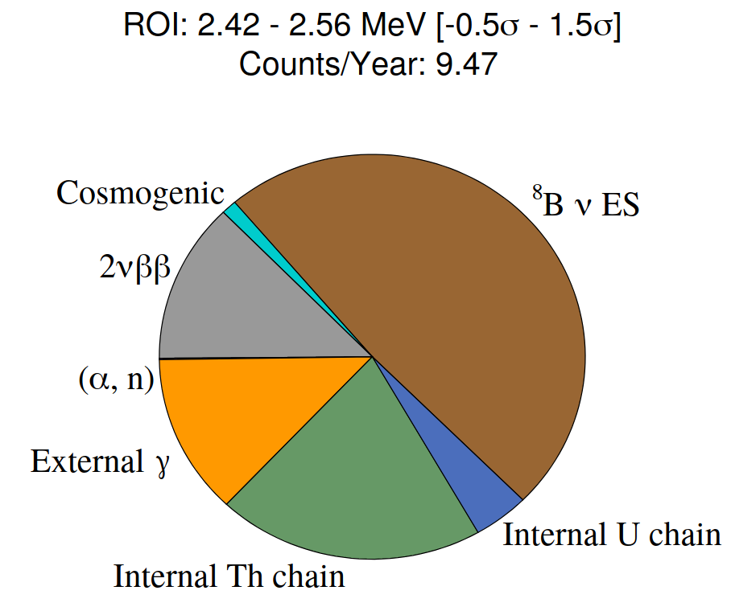
Double Beta Official Plots. Using Te+DDA Optics.
docDB-5681-v3
LAB+PPO+bisMSB+Te(0.5%)+Diol+DDA.

Slide 6
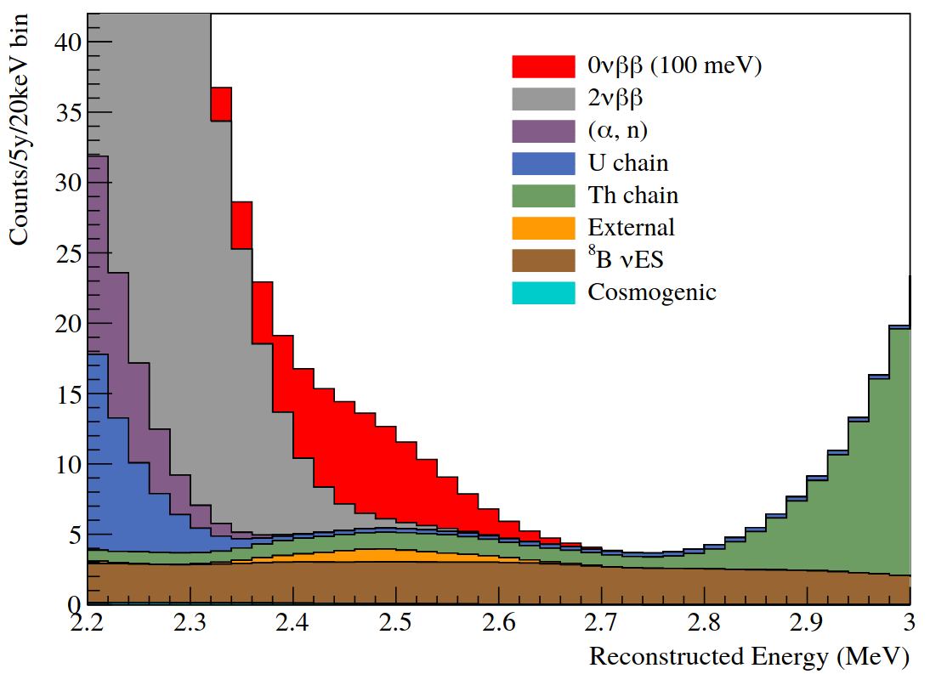

Slide 7
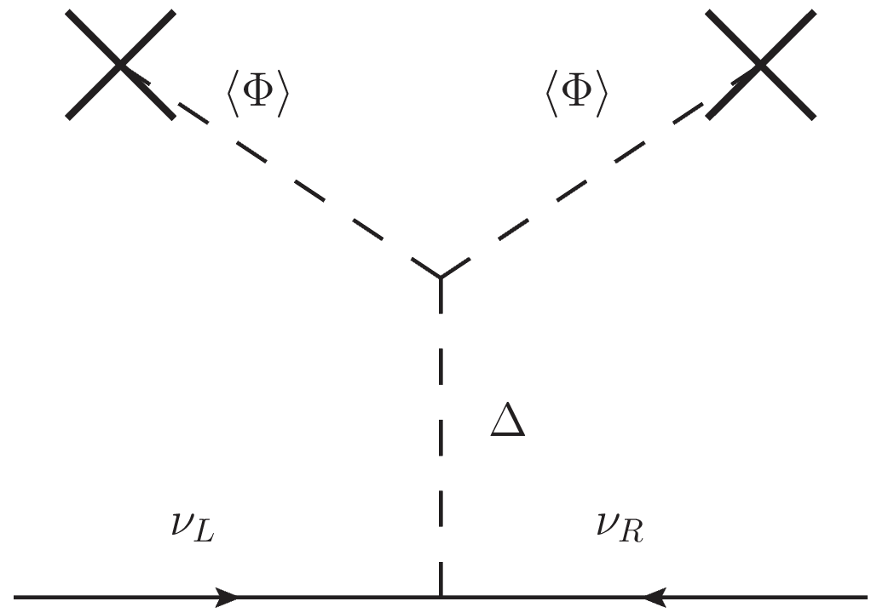
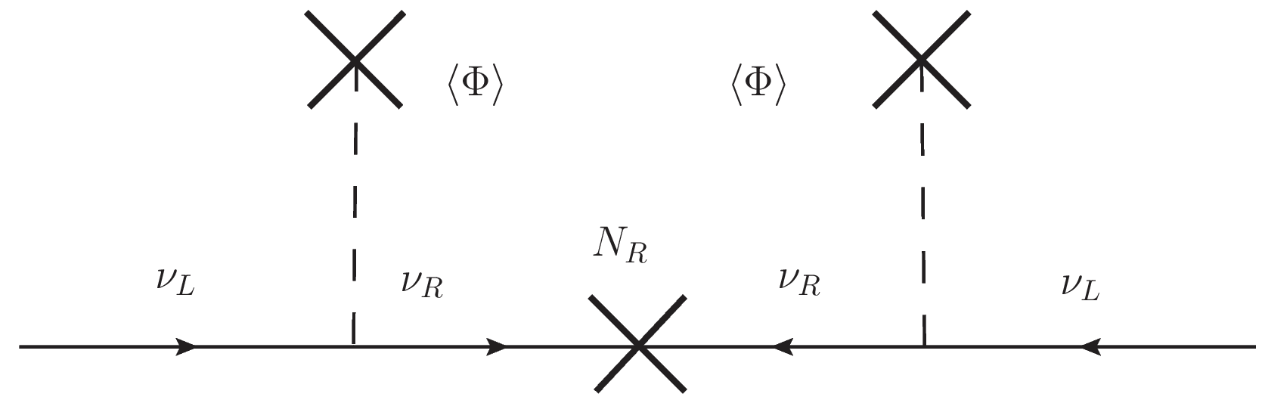

Slide 8
e⁻
ν
e⁻
θ
ν

Slide 9
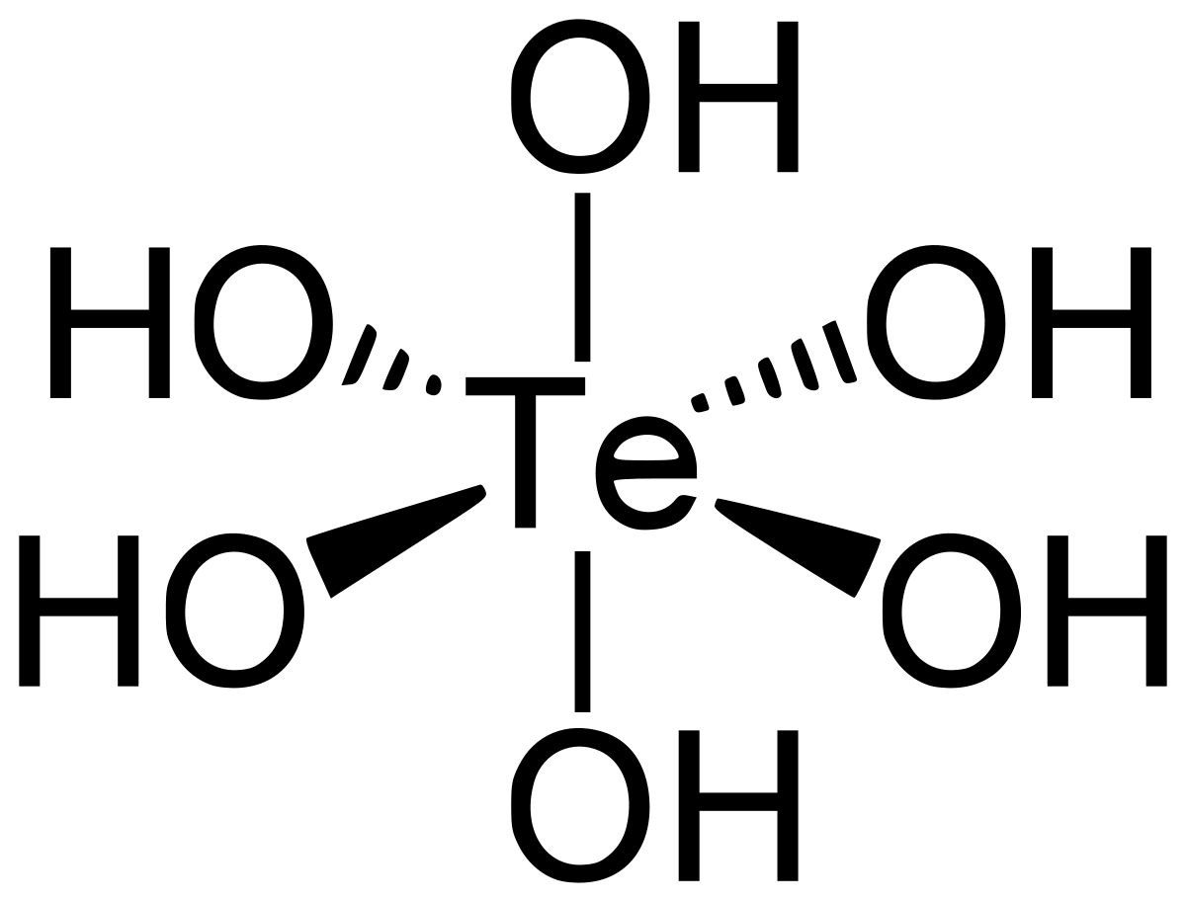
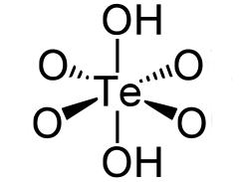
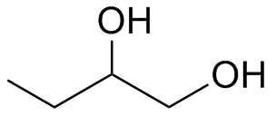
+
+
4H₂O
2
TeA
1,2-Butendiol
TeBD complex

Slide 10
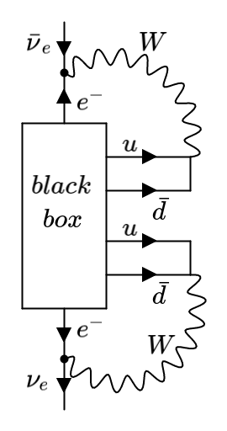
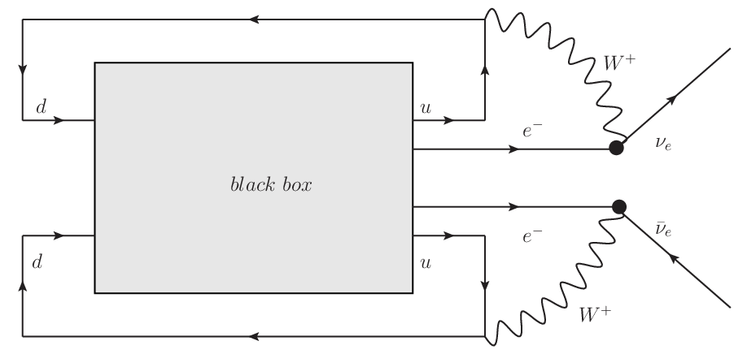

Slide 11
P₁
P
P₂
L
Ω
T₁
PMT sphere
θ
source
offset
O
time of flight
T₂
Ω'
L'
P'₁
P'₂
P'

Slide 12
a₊
PMT
a₊
PMT
ray-tracer
a₋
vertex
(a)
vertex
(b)
a₋
PMT
PMT
vertex
vertex
(c)
(d)

Slide 13
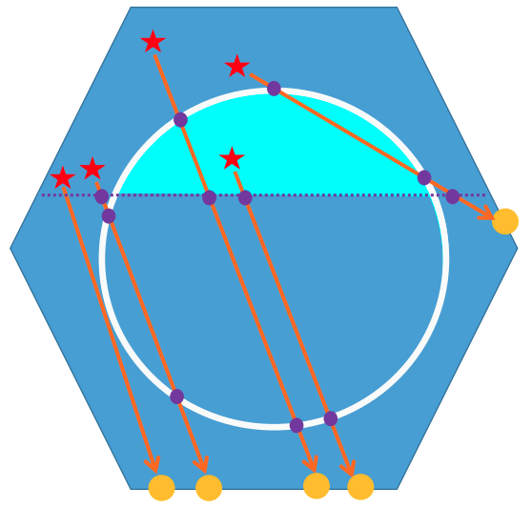
vertex
vertex
vertex

Slide 14

d_{neck}
d_{AV}

Slide 15
PMT
PMT
a₊
vertex
vertex
a₃
vertex
a₃
a₃
a₊
a₊
a₃
a₊
PMT
vertex
(a)
(b)
(c)
(d)
PMT
PMT
PMT
vertex
a₃
z₊
a₊
z₊
a₋
z₋
z₋
a₋
vertex
a₃
a₊
a₊
z₋
a₋
z₊
(e)
(f)
(g)
vertex
PMT

Slide 16
a'₊
a'₊
a₋
a'₊
a₊
a'₋
a₊
a'₊
(a)
(b)
(c)
(d)
a₊
a'₋
a'₊
a'₊
a'₊
a₊
a'₋
a₋
a₋
a'₋
a'₊
a₊
a₊
a'₋
a₋
(e)
(f)
(g)
(h)

Slide 17
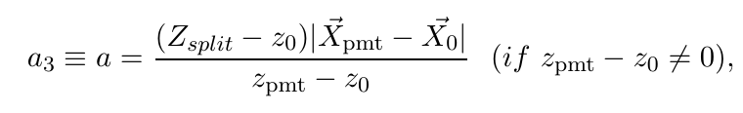
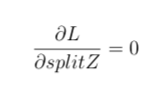
a₃
PMT
vertex
vertex
PMT
vertex
PMT
vertex
PMT

Slide 18
Hough transformation
X_{PMT}
θ_{Ch}
X₀
X₀

Slide 19
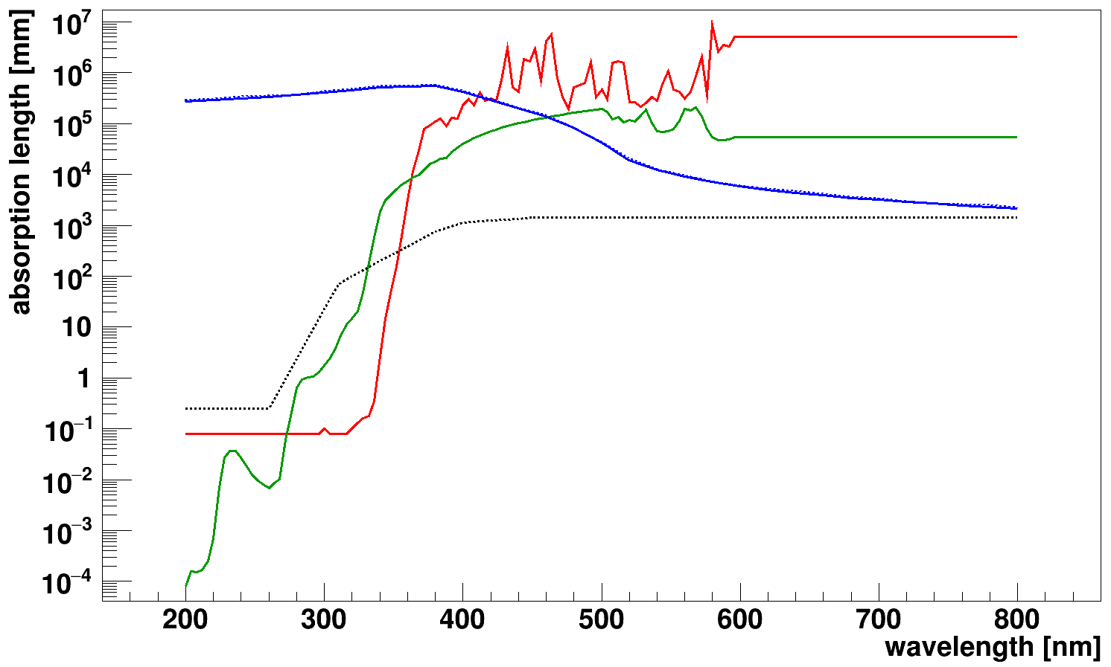
ＬＡＢＰＰＯ
— LAB
— PPO
--- Acrylic
— SNO+ internal water
--- SNO+ external water

Slide 20
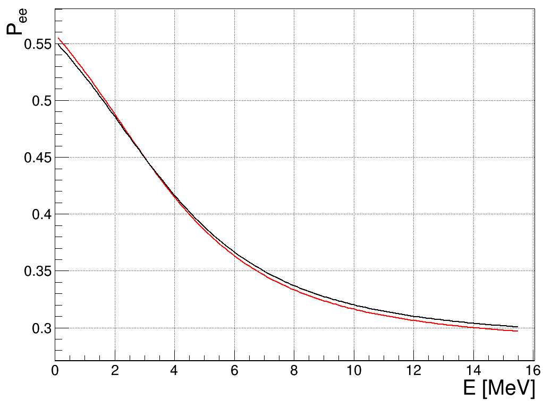

Slide 21
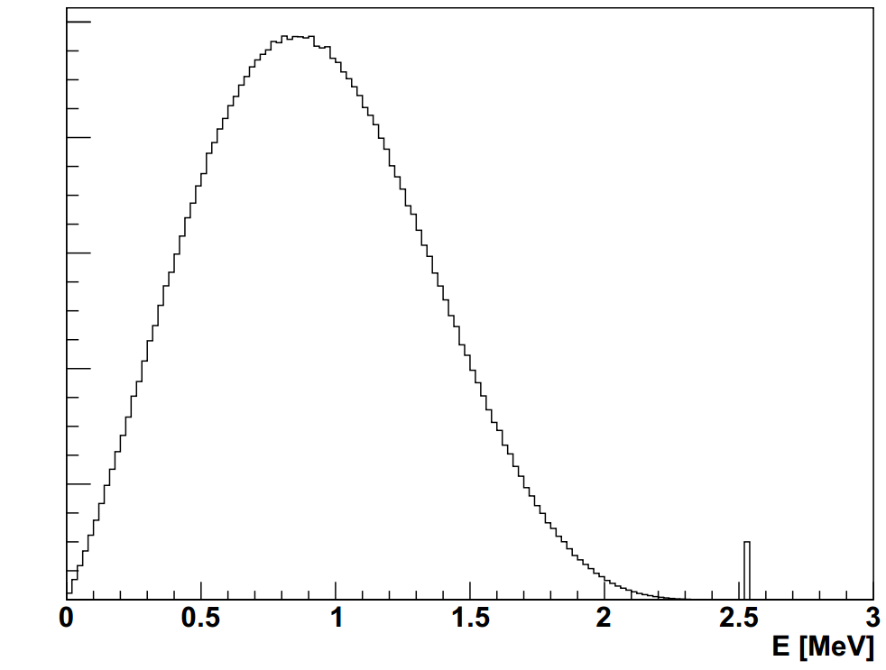
2νββ
counts
0νββ

Slide 22
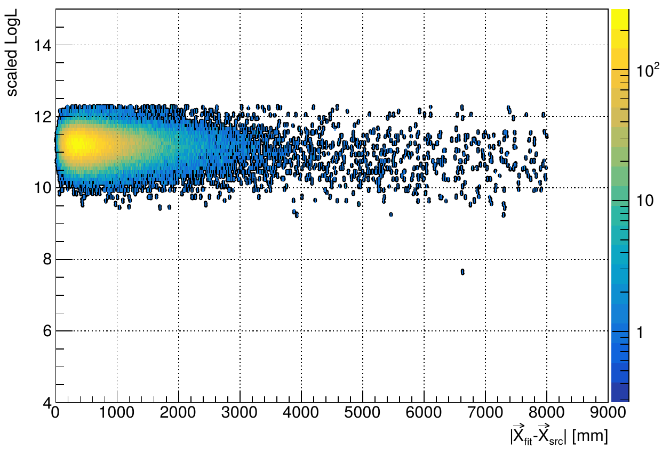
FOM cuts
scaleLogL>10
remove 0.128177%
events
mc

Slide 23
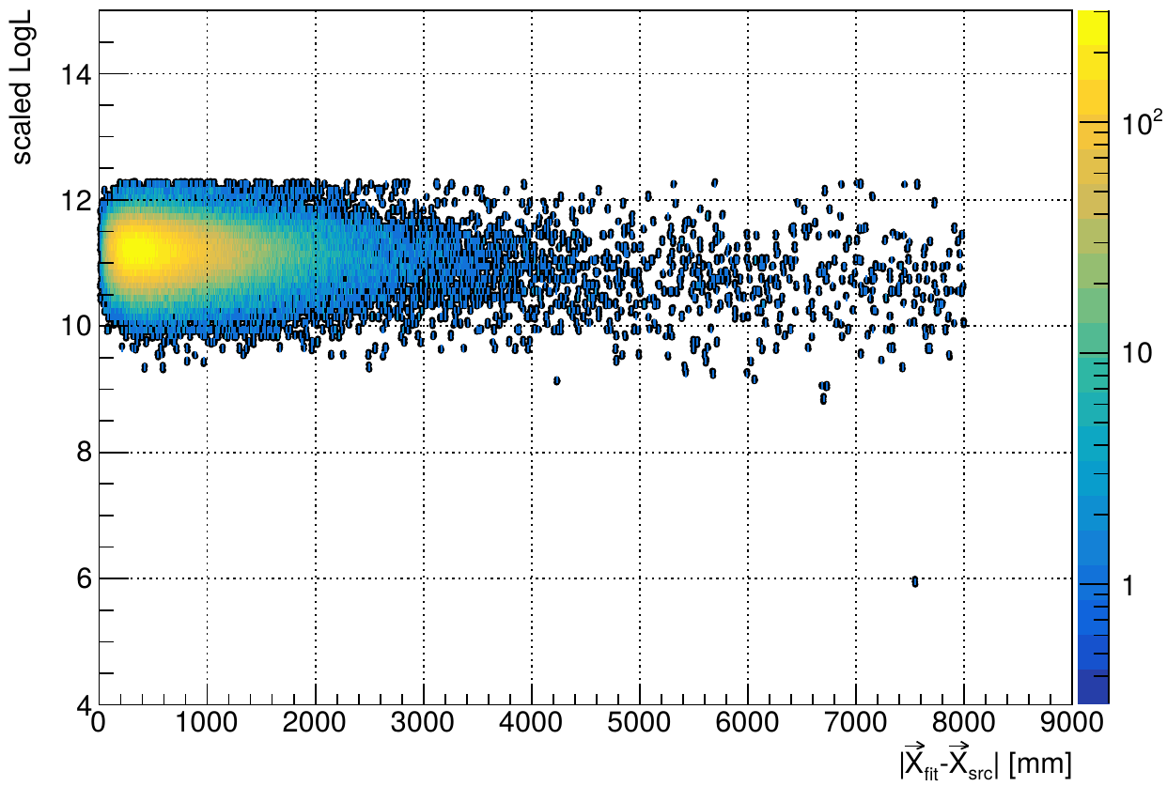
scaleLogL>10
remove 0.179641% events
data

Slide 24
SkyShine

Slide 25
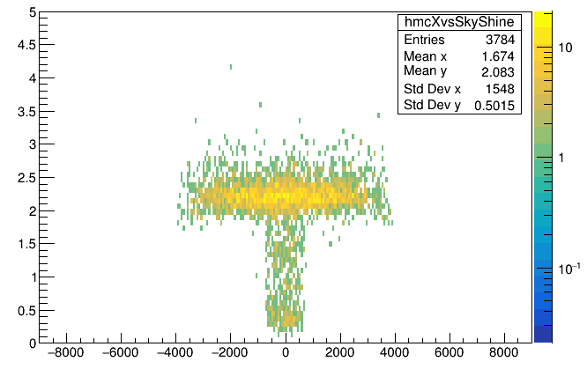
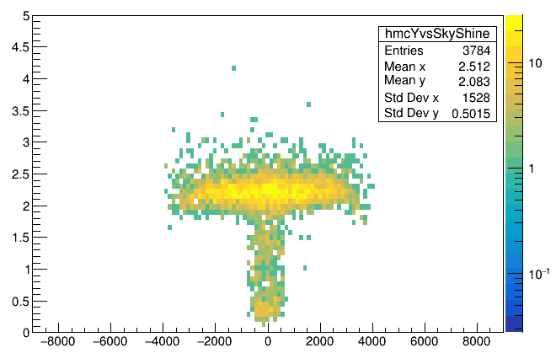
skyShine
x_{mc} [mm]
skyShine
y_{mc} [mm]

Slide 26
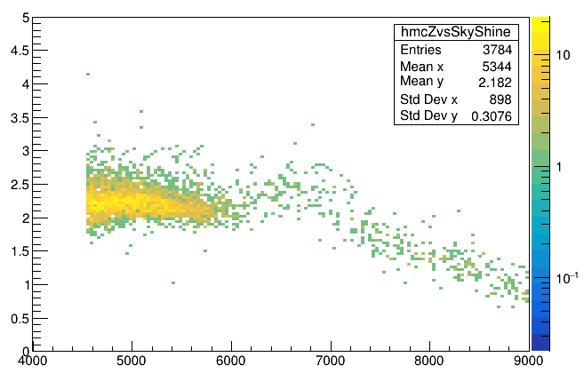
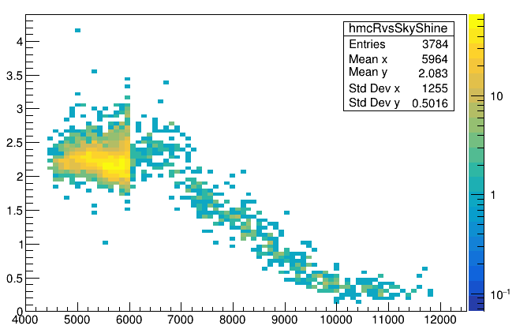
z>=neck
skyShine
skyShine<1.7
z_{mc}-108 [mm]
skyShine
skyShine<1.7
sqrt(x²_{mc}+y²_{mc}+(z_{mc}-108)²) [mm]

Slide 27
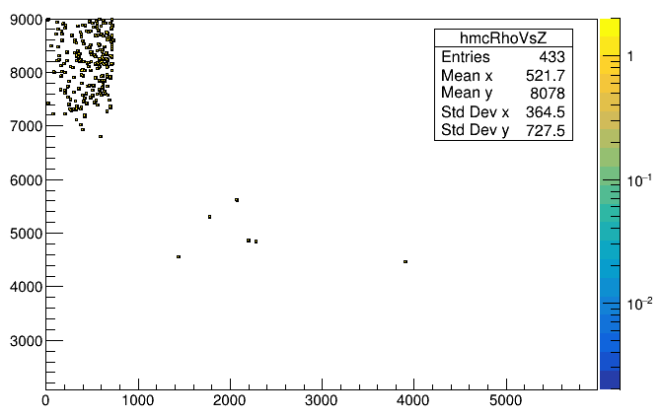
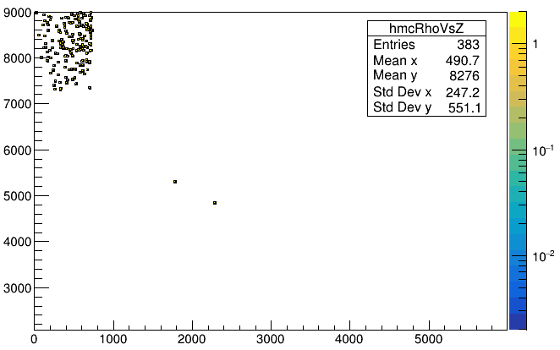
skyShine<1.7
Mostly are high neck region events
z_{mc}-108 [mm]
mis-tagged events
skyShine<1.5
Mostly are high neck region events
sqrt(x²_{mc}+y²_{mc}) [mm]
z_{mc}-108 [mm]
mis-tagged events
sqrt(x²_{mc}+y²_{mc}) [mm]

Slide 28
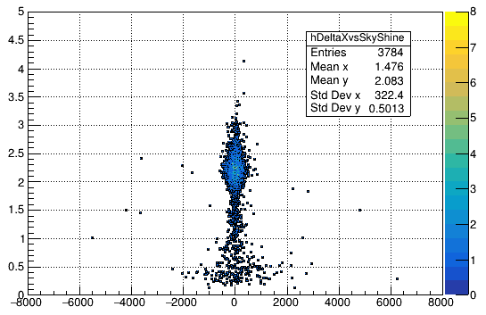
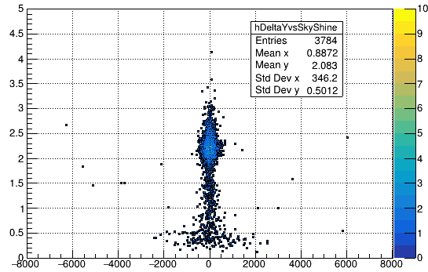
skyShine
skyShine
x_{fit} - x_{mc} [mm]
y_{fit} - y_{mc} [mm]

Slide 29
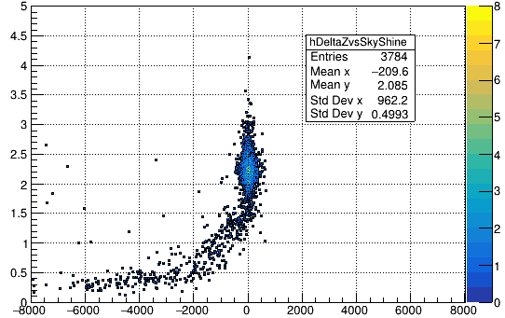
skyShine
z_{fit} - z_{mc} [mm]

Slide 30
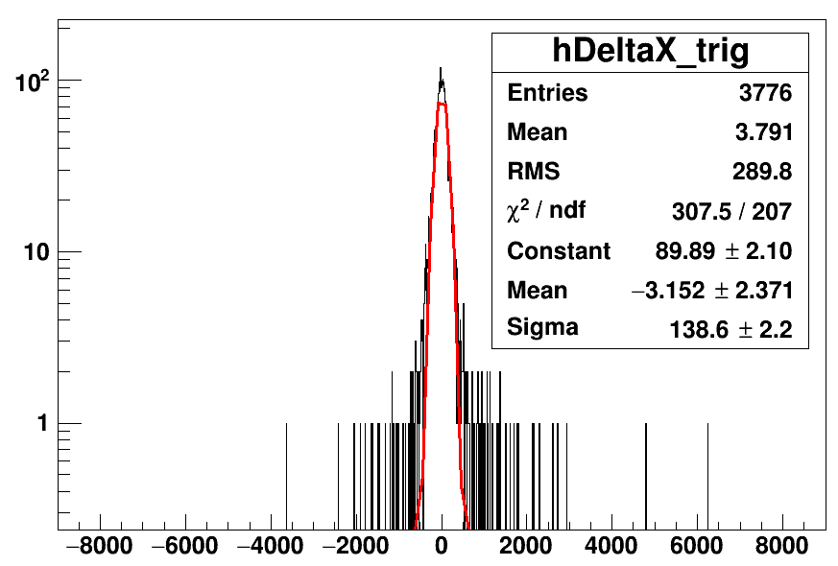
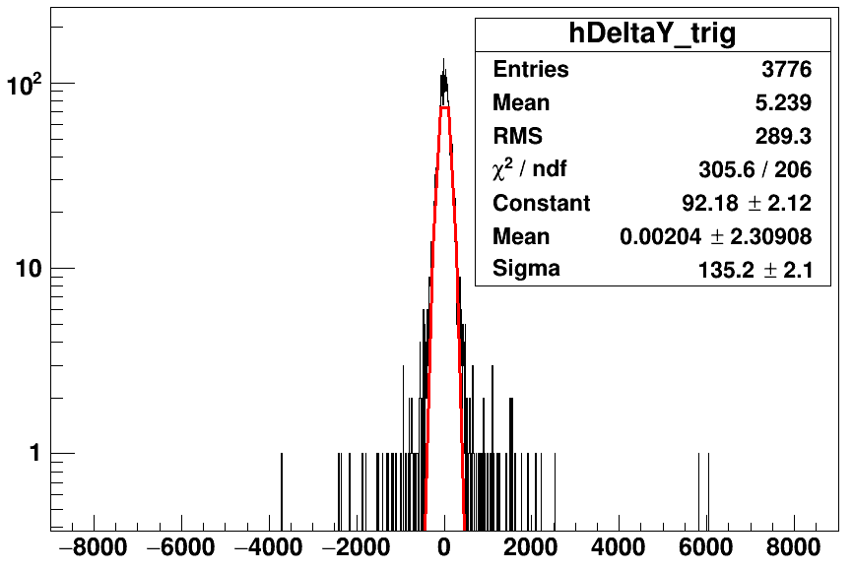
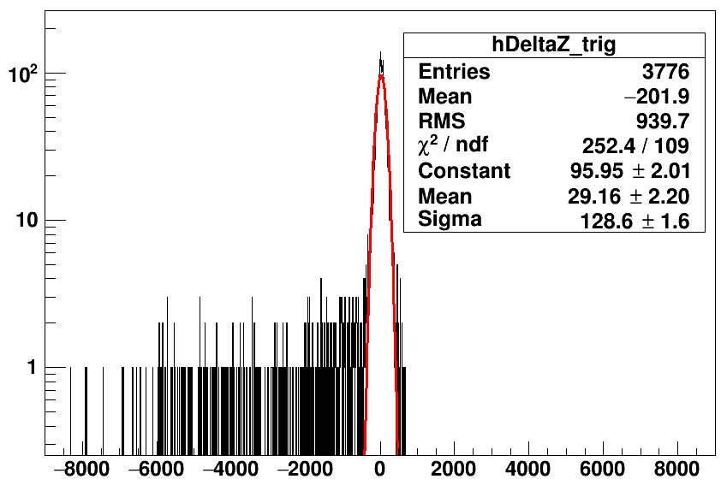
counts
counts
x_{fit} - x_{mc} [mm]
y_{fit} - y_{mc} [mm]
counts
Tl208 partialFill without cuts
z_{fit} - z_{mc} [mm]

Slide 31
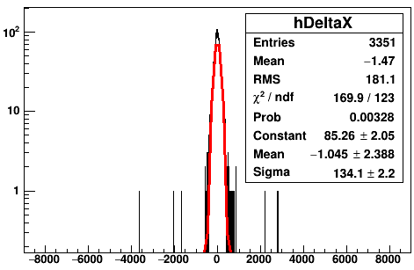
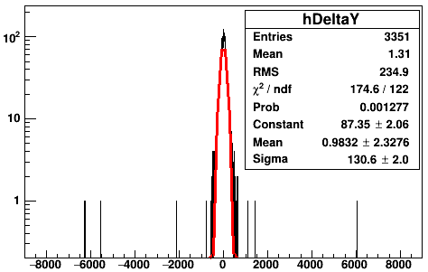
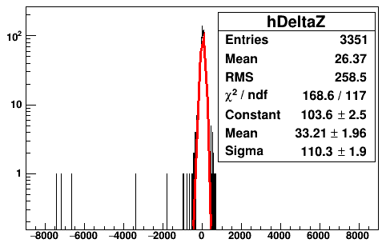
counts
counts
skyShine>1.7
skyShine>1.7
x_{fit} - x_{mc} [mm]
y_{fit} - y_{mc} [mm]
counts
skyShine>1.7
z_{fit} - z_{mc} [mm]

Slide 32
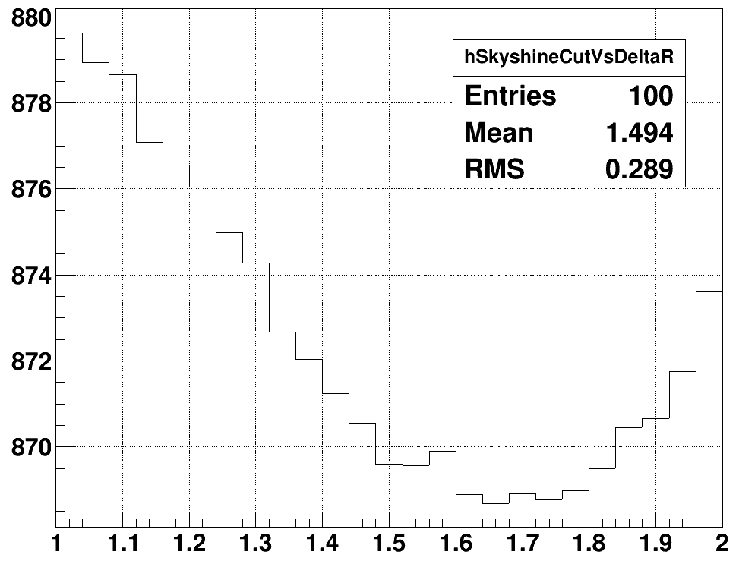
ΔR [mm]
1.65 (minimum)
1.75
skyShine

Slide 33
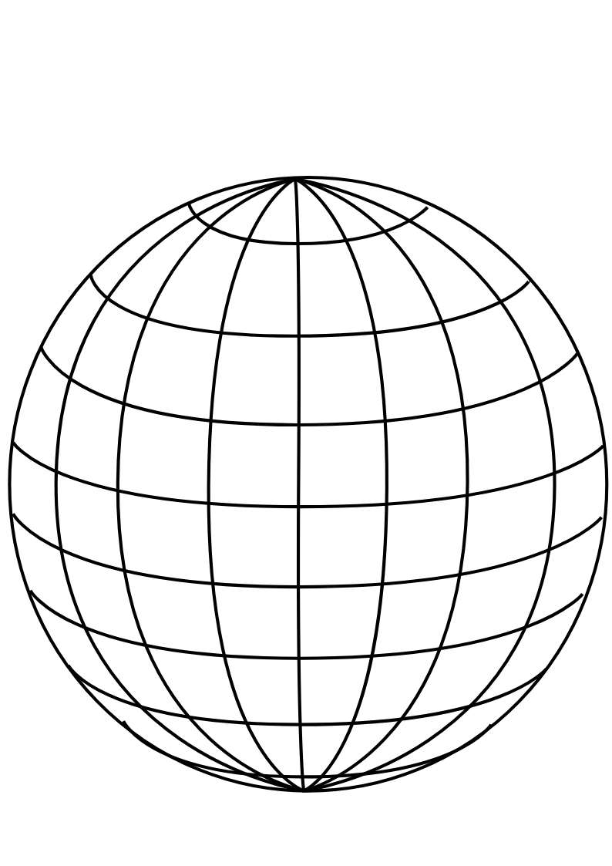
PMT
panel
Uniform Selector
PMT sphere
http://www.downloadclipart.net/download/5816/big-blue-wire-globe-svg

Slide 34
tuning group velocity
PMT hits
Cherenkov
cone
u
PMT sphere
actual event position
pulled event position

Slide 35
drive correction
early hits
late hits
Cherenkov
cone
u
PMT sphere
pulled event position
actual event position

Slide 36
u_{fit}
p₁
X_{fit}
X_{cor}
p₀
O
PMT sphere

Slide 37
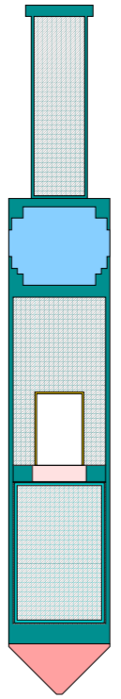
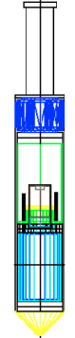
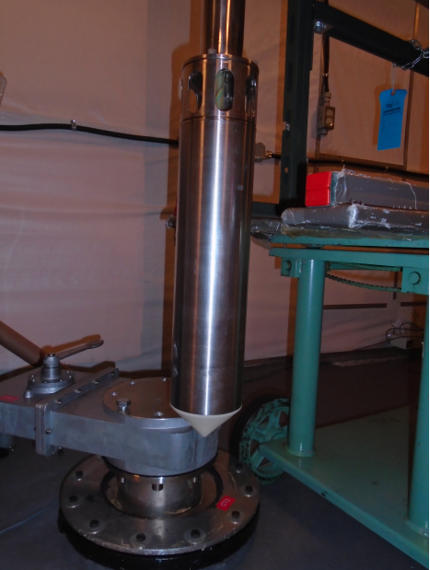
Stainless steel weight cylinder
“Lighthouse” gap, contains
material from scintillator volume
25.3 cm
Stainless steel container
PMT for tagging
Acrylic window
¹⁶N gas decay chamber
Plastic scintillator
Polyethelene bumper cone
5.7 cm

Slide 38
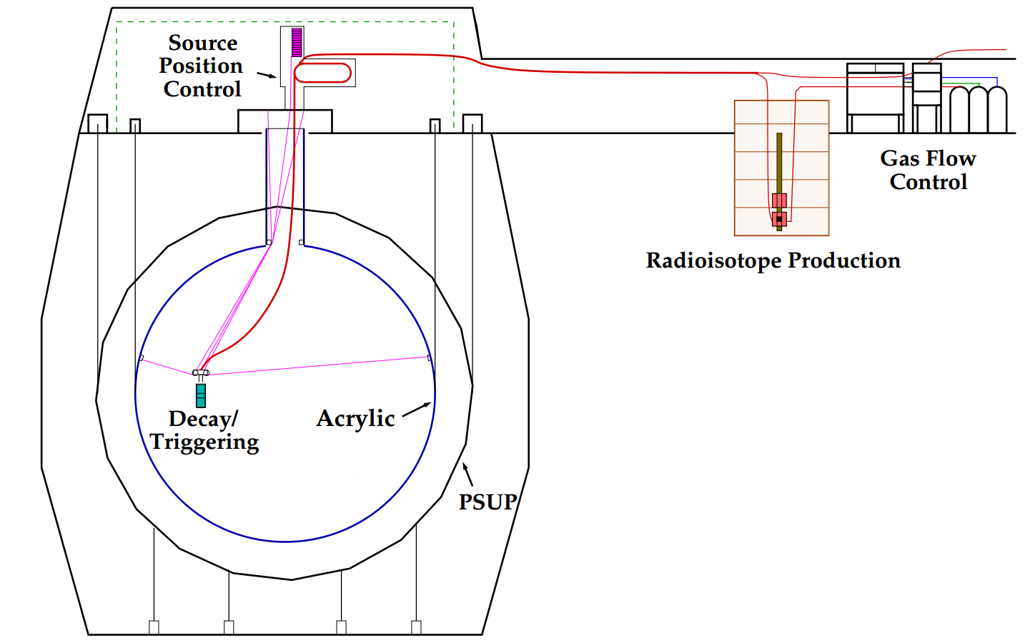
H₂O
H₂O
H₂O
hamer

Slide 39
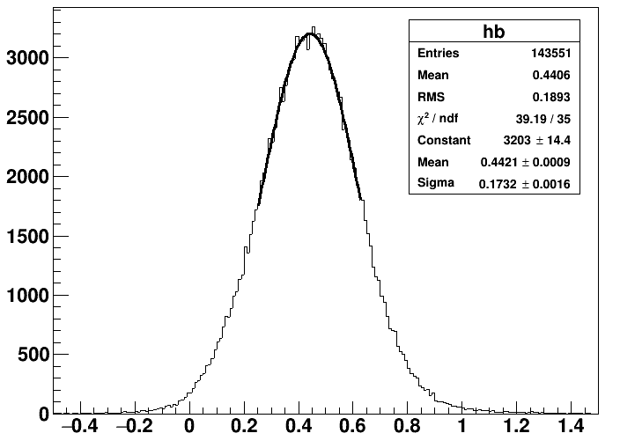
water analysis
fit in 1 sigma

Slide 40
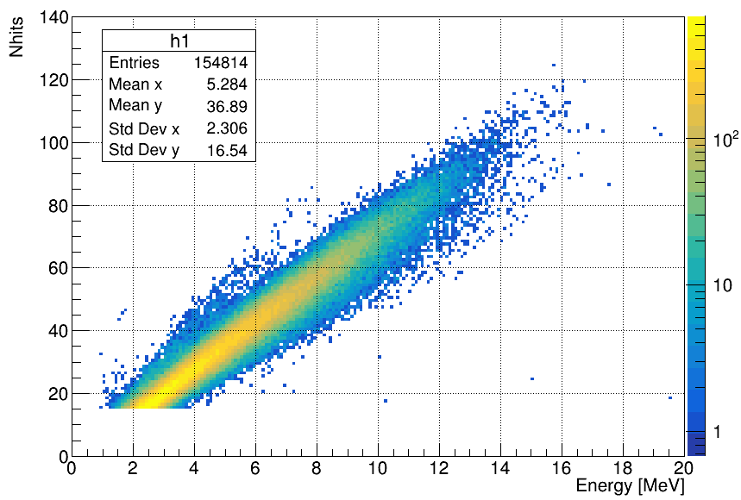
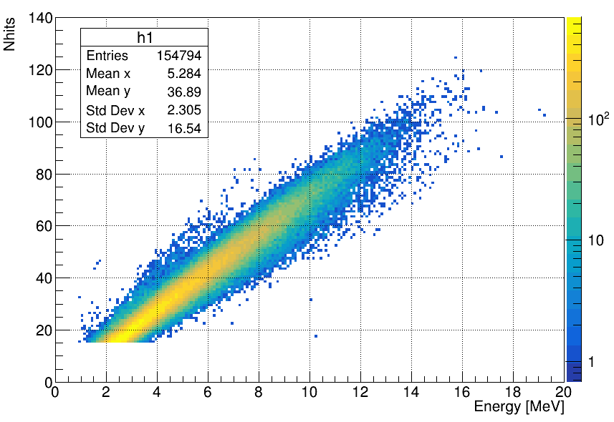
Merged_MPWsolarTest_WaterMP6176_nhit6_GeneralPhysicsMC_WaterSolar_NueRun_r200004to200781.root
T->Draw("nhits:energy>>h","Gtest>0","colz")
Gtest>0
185639/185410
Gtest>0

Slide 41
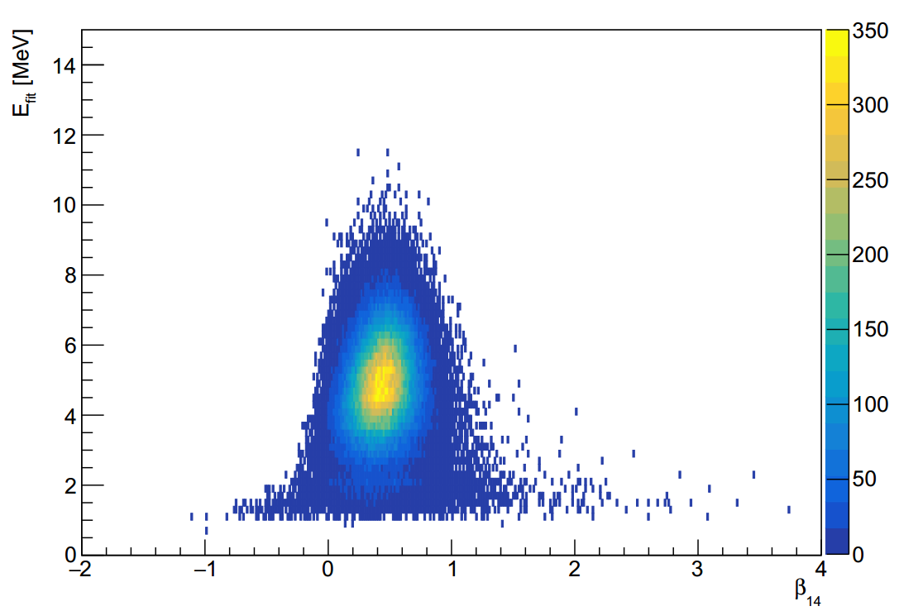

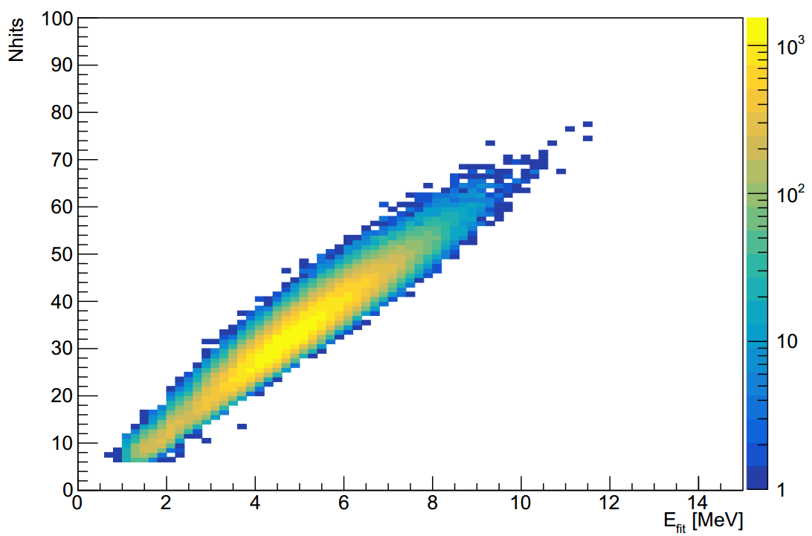
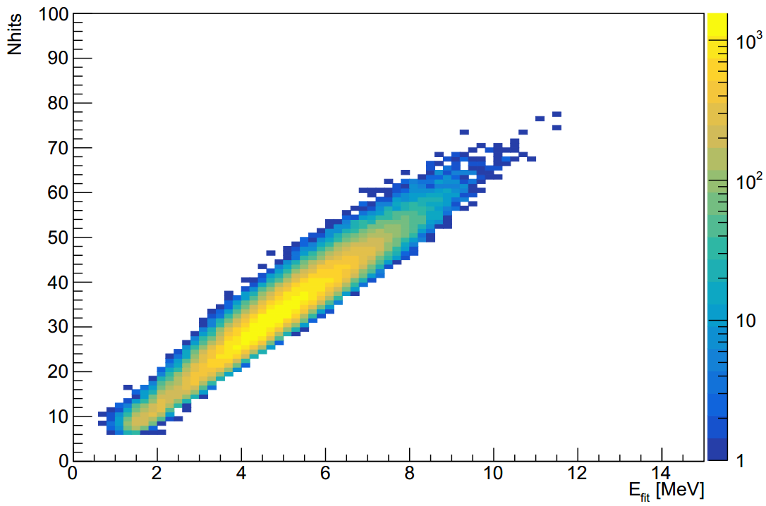
MPW MC
RAT MC
MPW MC
RAT MC

Slide 42
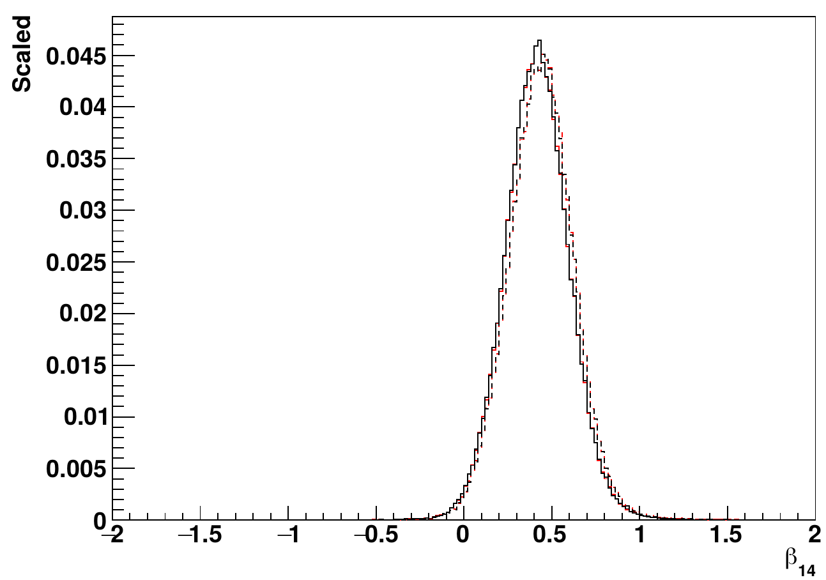
¹⁶N source
central run-107055
— RAT data
— MPW data
--- RAT MC
--- MPW MC

Slide 43
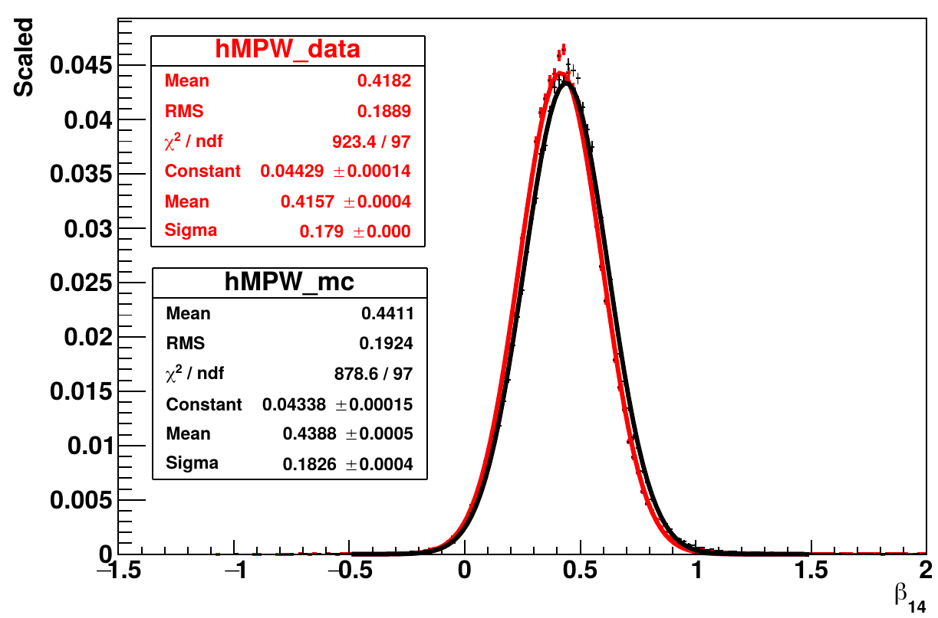
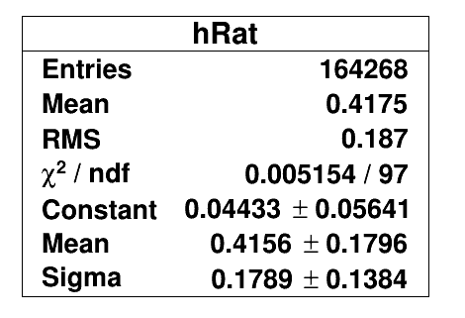
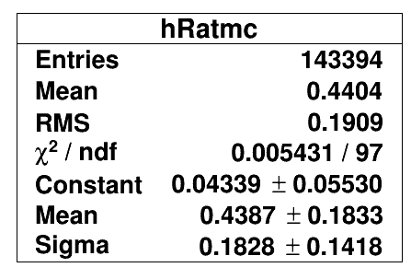
— MPW data
— MPW MC

Slide 44
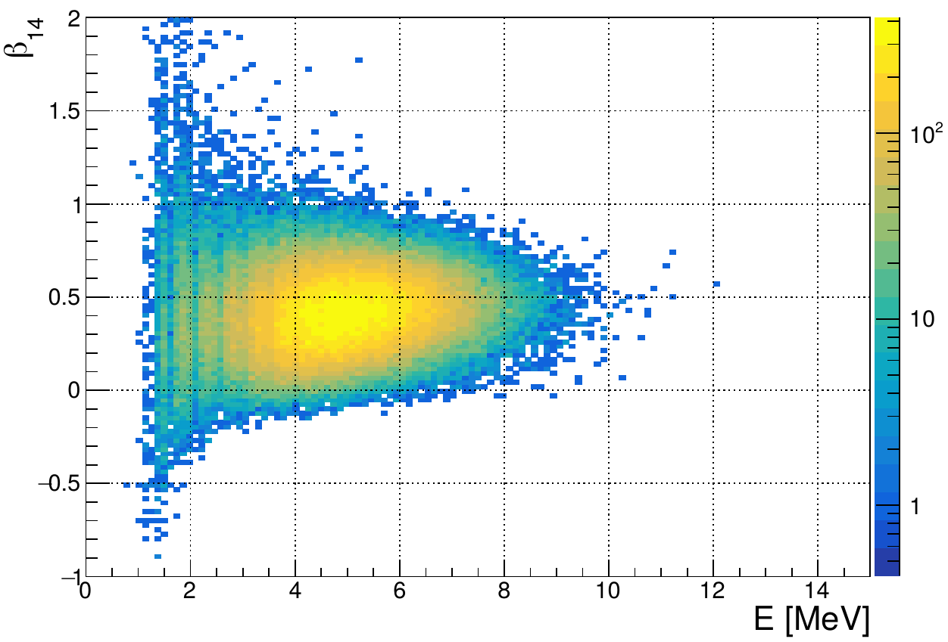
MPW data
107055

Slide 45

MPW MC
107055

Slide 46

RAT data
107055

Slide 47

RAT MC
107055

Slide 48



Slide 49


Slide 50


Slide 51


Slide 52


RAT
MPW

Slide 53




111230
Rat MC
111230
MPW MC
MPW
Rat
MPW
Rat

Slide 54

¹⁶N source
central run-107055
— RAT data, uncleaned
— Rat data, cleaned
164268/172408
data clean removes ~4.72% of the events

Slide 55







RAT external solar Nue
MPW external solar Nue
RAT inner solar Nue
MPW inner solar Nue

Slide 56



MPW
scaleLogL<8
RAT
MPW
posRad>6005 && nhits>14
MPW
scaleLogL>12

Slide 57


photoelectric absorption
— Compton scattering
--- pair production

Slide 58
¹⁶N
γ-rays
θ_{PMT}
θ_{e}
X_{true}
e⁻
X_{fit}
PMT

Slide 61

Exwater: solar nu, Tl208, Bi214
²¹⁴Bi
²⁰⁸Tl

Slide 62

¹⁶N source
central run-107055
— RAT data
— MPW data
--- RAT MC
--- MPW MC
NHits

Slide 63

¹⁶N source
central run-107055
— RAT data
— MPW data
--- RAT MC
--- MPW MC

Slide 64

¹⁶N source
central run-107055
r<5.3 m
— RAT data
— MPW data
--- RAT MC
--- MPW MC
¹⁶N source
central run-107055
r<5.3 m
— RAT data
— MPW data
--- RAT MC
--- MPW MC

Slide 65


Slide 66


Slide 67
β₁₄
fitted event position
r_{i}
fitted event direction
θ_{ij}
r_{j}

Slide 68

γ-rays

Slide 69

— 5 MeV
— 4 MeV
— 3 MeV
— 2.5 MeV
— 1 MeV

Slide 70
¹⁶N source
distance
γ-rays
X_{fit}
Compton
scattering
e⁻
θ_{PMT}
PMT

Slide 71


6.17.6
6.5.2
output->Draw("energy>>henergy","waterFit && ( ((dcApplied & 0xFB0000017FFE) & dcFlagged) == (dcApplied & 0xFB0000017FFE) )")

Slide 72

muon induced
10C

Slide 73

10C

Slide 74

11C

Slide 75

11C

Slide 76

6He

Slide 77

6He

Slide 78

Solar phase
11C

Slide 79


Slide 80


Slide 81


Slide 82


Slide 83
stainless steel
container
scintillation vial
PMT #1
PMT #2
plastic piece
stainless steel stand
¹³⁷Cs source
dark box
HV
connector
HV supply
computer
signal/HV
split box
signal/HV
split box
amplifier
amplifier
CAEN
digitizer

Slide 84


scintillation
vial
49.4 mm
14.3 mm
stainless steel
PMT container
plastic holder
30 mm

Slide 85

— LAB-PPO
— TeSOP
— TeDDA
— background

Slide 86

LAB-PPO
multiple p.e.
peak
single p.e.
peak

Slide 88

TeDDA

Slide 89

TeSOP

Slide 90
(a)
(b)
LAB-PPO
TeSOP
single p.e. peak
multiple p.e. peak
(c)
(d)
TeDDA
— LAB-PPO
— TeSOP
— TeDDA
— background

Slide 91
(a)
(b)
LAB-PPO
Te_P1
single p.e. peak
multiple p.e. peak
(c)
(d)
Te_P3
— LAB-PPO
— Te_P1
— Te_P3
— background
This is for publish paper

Slide 92

trigger
trigger
hold-off
integral
time window
pre-gate
threshold
baseline

Slide 93

zero peak
— LAB-PPO without coincidence cut
— LAB-PPO with coincidence cut
single p.e. peak
threshold for counting
multiple p.e. peak

Slide 94


21 Mar 2019

Slide 95


Slide 96

— ²⁰⁸Tl internal
--- ²⁰⁸Tl AV
— ²¹⁴Bi internal
--- ²¹⁴Bi AV
— solar ν_{e}
Internal background vs solar ν_{e} (FV<5.5 m)

Slide 97

— data
— fit
χ²/ndf = 0.87
counts/0.2 bin
Signal
fitted: 67.1+- 9.2 events
1.04 +- 0.14 event/(day*kiloton)
Background
fitted: 3.4 +- 0.91 events
0.05 +- 0.01 event/(day*kiloton)
cosθ_{sun}

Slide 98

counts/0.05 bin
cosθ_{sun}

Slide 99

¹⁶N central run-107055 data
0.61<U<0.95 suggested by the
collaboration
Remove 0.34% events

Slide 100

¹⁶N central run-107055 MC
0.61<U<0.95 suggested by the
collaboration
Remove 0.38% events

Slide 101

¹⁶N central run-107055 data
0<G<1.9 suggested by the
collaboration
Remove 0.01% events

Slide 102

¹⁶N central run-107055 MC
0<G<1.9 suggested by the
collaboration
Remove 0.01% events

Slide 103

¹⁶N central run-107055 data
-11<Z’<1 suggested by the
collaboration
Remove 0.13% events
total 0.37% events

Slide 104

¹⁶N central run-107055 MC
-11<Z’<1 suggested by the
collaboration
Remove 0.13% events
total 0.4% events

Slide 105

2.5 MeV e-, full scint

Slide 106

2.5 MeV e-, full scint

Slide 107

2.5 MeV e-, full scint

Slide 108


Slide 109


Slide 110

Fitted radial biases vs group velocities, tuning 0.5 g/L PPO
velocity [mm/ns]
radial bias [mm]

Slide 111

velocity [mm/ns]
radial bias [mm]

Slide 112

3 MeV e- at splitZ = 3000 mm
in inner_av_bottom

Slide 113

3 MeV e- at splitZ = 3000 mm
in inner_av_bottom

Slide 114


Slide 115

^{—— 214}Bi
--- ²¹⁴Po
Bipo214

Slide 116


Slide 117

2.5 MeV e-, full scint

Slide 118
— ²⁰⁸Tl internal
--- ²⁰⁸Tl AV
— ²¹⁴Bi internal
--- ²¹⁴Bi AV
— solar ν_{e}

Slide 119


MLP
4<E<15 MeV
MLP
4<E<5 MeV

Slide 120

BDT
4<E<15 MeV

Slide 121

Fisher
4<E<15 MeV

Slide 122

LD
4<E<15 MeV

Slide 123

BDT
4<E_{fit}<15 MeV

Slide 124

MLP
4<E_{fit}<15 MeV

Slide 125

BDT
5<E_{fit}<15 MeV

Slide 126

MLP
5<E_{fit}<15 MeV

Slide 127


BDT, hi E

Slide 128


MLP, hi E

Slide 129

— data
--- MC
100207

Slide 130

— solar ν_{e}
--- pdf scaled
— ²¹⁴Bi
.... pdf scaled

Slide 131

—— ν_{e} without oscillation
—— ν_{e} + ν_{μ} including oscillations
------ ν_{e} including oscillations

Slide 132
z
O
θ_{Ch}
y
Cherenkov cone
x

Slide 133
z
event
O
y
light path
x

Slide 134

θ_{sun} = 0°

Slide 135
Systematics position resolution

